Slide 1
Landesverband
Nordrhein-Westfalen
Professionalization of teachers in
communal adult education centres (Volkshochschulen) in Germany - an overview
Filip Dedeurwaerder-Haas
Head of Languages and Teacher Training of the Landesverband der Volkshochschulen of North-Rhine-Westphalia (NRW VHS Association)

Slide 2
„Teachers in adult education centres
remain loyal to their centre
for an average of 8 years“
(WB Monitor 2005)

Slide 3
Professionalization of teachers in communal A.E. (VHS) in Germany
Contents
VHS in Germany
VHS structures on federal and national level
VHS teacher profile
VHS qualification curriculum
Implementation of qualification in Germany
Adaption in North-Rhine-Westphalia „EPQ“
Further teacher trainings
Tools based on VHS teacher profile

Slide 4
Professionalization of teachers in communal A.E. (VHS) in Germany
Communal Adult Education - Volkshochschulen
VHS are public institutions for Adult Education
work as community centres for continuing education and contribute to the local services
40% public funding, 20% external funding (federal, EU), 40% income from course fees
60% organized and supported by the local authorities 30% registered associations, 10% special legal status (private ownership/limited comp.).
924 VHS in Germany
with 3,118 regional field offices
672 managers, 3,200 educational staff, 3,800 admin staff
200,000 self-employed/freelance staff
Notes:
fundamentally open for everything that can be secured for community services at an affordable price through independence from ideology and partisan politics.
aligned to the orientation, education and training interests of the participants, to the development of individual potential, professional further education and the recognition of qualifications and contribute to social integration
offering the educationally disadvantaged target groups a second chance
policy, society, environment, culture, style, health, languages, work, occupation, basic education, educational certificates, literacy, basic education, remedial education, integration courses, language certificates. ("telc language certificates“, professional "Xpert certificates")

Slide 5
VHS structures on federal and national level
German adult education association (DVV)
18 federal state associations (VHS-Landesverbände)
Represent members in educational and political matters (national and EU)
Support co-operation and experience exchange among members, develops policies and guidelines
Support VHS staff through trainings
Implements certificates through organization of exams and examiner-trainings

Slide 6
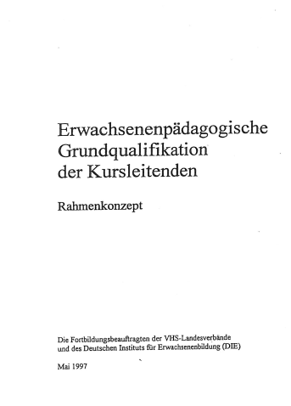
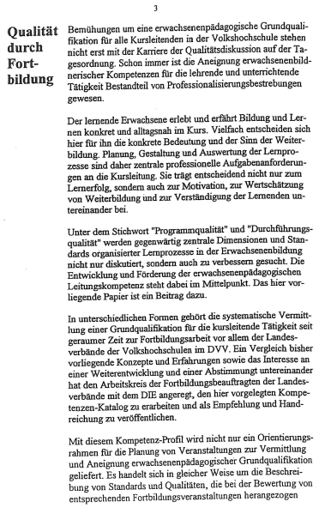
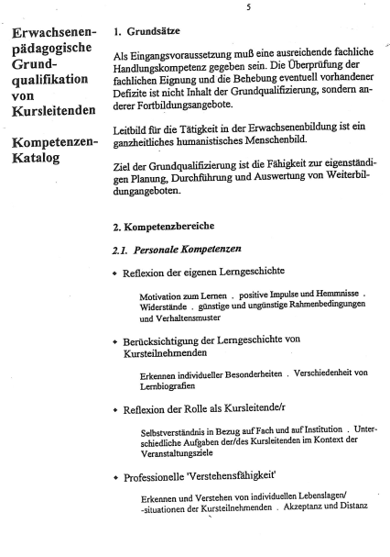
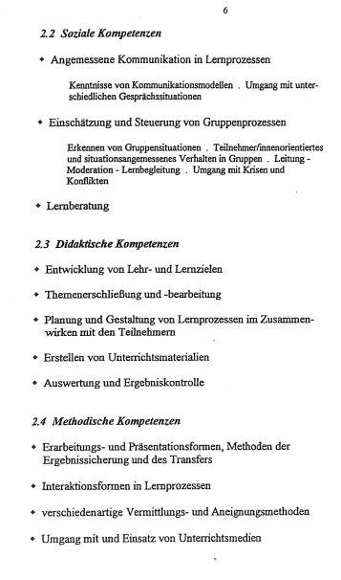
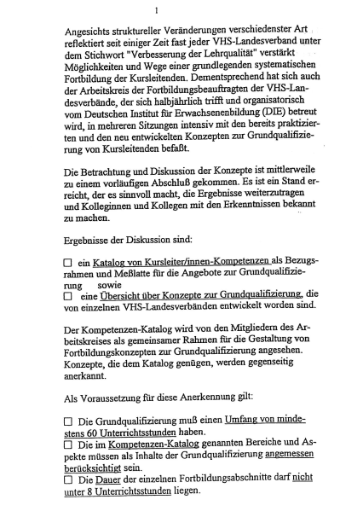
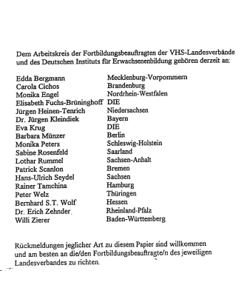
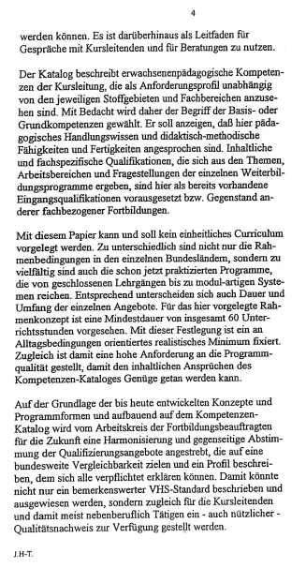
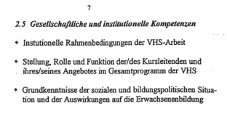
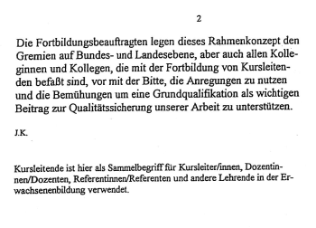
VHS teacher profile and training (May 1997)
General concept by DVV, 18 Landesverbände and D.I.E.
holistic humanistic approach
min. 60 hrs
min 8 hrs/day
professional requirements

Slide 7
VHS teacher profile – professional requirements
Andragogical skills
Complementary skills
Functional/technical skills (on specific subject)
Overall skills (exceeding specific subjects)
Managerial skills
Self-reflective skills
Social skills
Didactical skills
Methodical skills
Advisory/Consulting skills
Institutional skills
German Qualification Framework
Level 6/7
Notes:
GQF (European Qualification Framework): Flexi-Path (EU-Project by DIE)

Slide 8
Implementation in Germany
Qualifications based on DVV-curriculum on offer in all federal states
General recognition by all ”Landesverbände”
Variations
regarding contents: e.g. language-teacher specific training (Bavaria/Hesse: Eurolta)
regarding approach: classical training vs. blended learning modular vs. curricular
regarding length: 60 to 120 hrs
regarding recognition by universities

Slide 9
Implementation in North-Rhine-Westphalia

Slide 10
Further teacher trainings (1)
Additional qualification for teachers in “Integrationskurse“ (language courses for migrants)
German-wide recognition
Financed by BAMF (Federal Office for Migration and Refugees)
Various qualifications for:
General integration courses (A1-B1): 70-140 hrs
Literacy courses (A1-B1): 80 hrs
Civic education (B1): 30 hrs

Slide 11
Further teacher trainings (2)
Examiner trainings – compulsory, organized via Landesverbände (telc, Goethe, Cambridge, XPert, ECDL…)
telc „Weiterbildungsprogramm“
„the European language certificates“ Co.
Subsidiary of DVV (German VHS Association)
Offer trainings for language teachers
Exam-related training topics

Slide 12
Further teacher trainings (3)
Trainings/Courses organized by “Landesverbände” curricular trainings, singular trainings, co-operation with universities
e.g. Sprachentage (Language Days)
e.g. Kursleitertage (Teacher Days)
Trainings/Courses organized by individual VHS

Slide 13
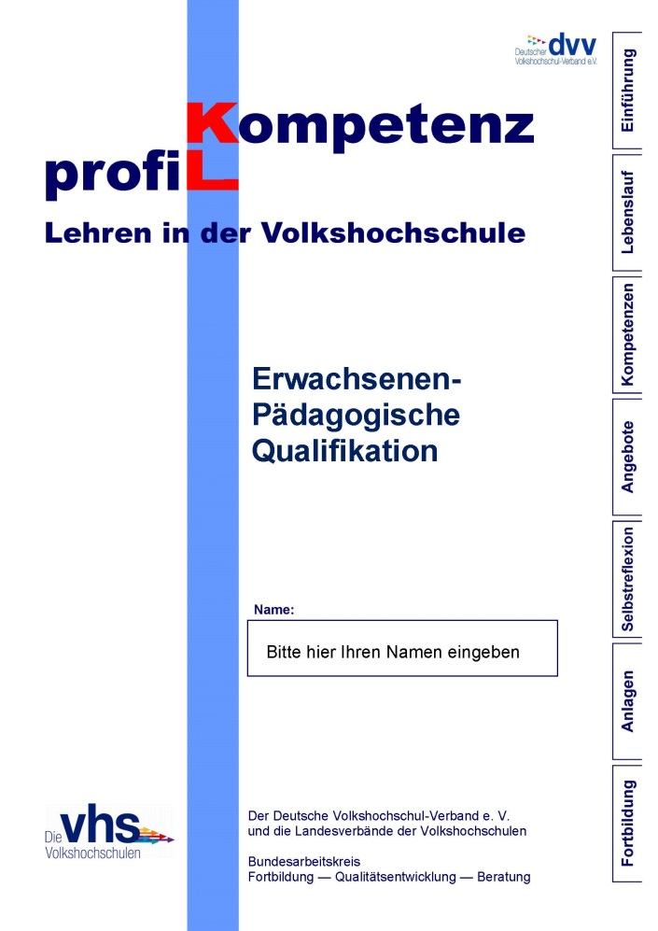
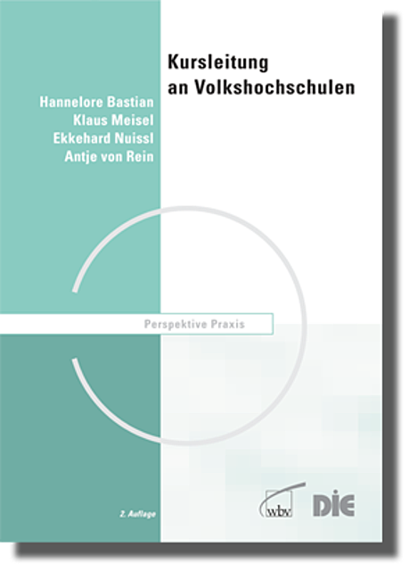
Tools based on VHS teacher profile
DVV D.I.E.

Slide 14
Filip Dedeurwaerder-Haas
Landesverband der VHS von NRW e.V.
Bismarckstraße 98
D-40210 Düsseldorf
dedeurwaerder@vhs-nrw.de

